Slide 1

This week’s agenda
PART 10
Concept of Robustness
Concept of Optimality
Concept of Adaptive Systems
Concept of Intelligence in Control

Slide 2
P-10 Concept of Robustness
+
U(s)
R(s)
Σ
C(s)
P(s)
Y(s)
_
1
P(s)=
s²+αs+1
If a controller C(s) meets the design specifications for every α in a known range α_{min} ≤ α ≤ α_{max} then the controller is a robust controller, and the control system is robust against variations in α.

Slide 3
Concept of Robustness
q₃
q₂
q₁
If this robot grasps a load, some parameters seen in its dynamical representation change. If a position control application is being executed, the controller must take this change into account to maintain precision.

Slide 4
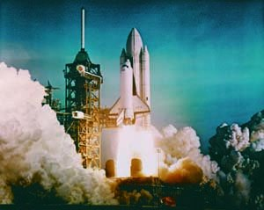
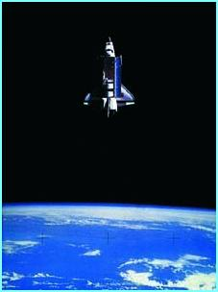
P-10 Concept of Optimality
Limited fuel
A particular trajectory
must be followed
Define a cost function letting you balance the importance of these issues, and find a way to minimize it

Slide 5
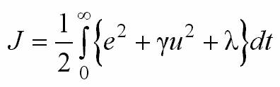
Concept of Optimality
+
e(t)
u(t)
r(t)
Σ
C(s)
P(s)
y(t)
_
Design C(s) such that
is minimized
Large γ increases the
relative importance of
fuel consumption
Large λ increases the
relative importance of
time

Slide 6
P-10 Concept of Adaptive Systems
1
P(s)=
s²+αs+1
+
U(s)
R(s)
Σ
C(s)
P(s)
Y(s)
_
DESIGN
C(s)
ESTIMATE
α
α
^
If α is unknown, we can devise an estimation scheme; and based on the estimated value α, we can perform the design, and operate the controller in the loop.
^

Slide 7

P-10 Concept of Intelligence in Control
μ(color)
Color
Knowledge
Base
Inference
Engine
Defuzzification
Fuzzification
Input
Output
Rule Base

Slide 8
Concept of Intelligence in Control
All other
expert knowledge
LEARNING
MECHANISM
New
parameters
r(t)
Σ
INTELLIGENT
CONTROLLER
PLANT
_
u(t)
y(t)
+

Slide 9
Concept of Intelligence in Control
!
INTELLIGENT
CONTROLLER
Excitation
Control Signal
Architectural
Considerations
ADAPTATION
Computational
Considerations
Performance
Considerations
Robustness & Stability
Considerations

